Slide 1

Predictive Learning from Data
LECTURE SET 9-2
SVM Practical Issues and Application Studies
Electrical and Computer Engineering

Slide 2
OUTLINE
Practical issues for SVM classifiers
- input scaling
- unbalanced settings
- multi-class problems
- SVM optimization implementations
Univariate histograms for SVM classifiers
SVM model selection
Application studies
Summary

Slide 3
SVM Practical Issues
Understand assumptions for classification setting & relate them to applic. requirements, i.e. performance indices
Data Scaling scale all inputs to [0,1] range
Type of SVM problem
- classification (binary, multi-class, …)
- regression
- single-class learning
- etc.
SVM Optimization Algorithms

Slide 4
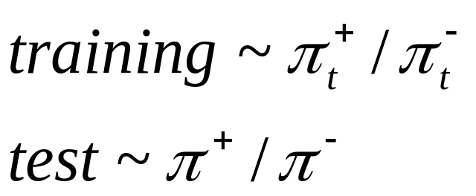
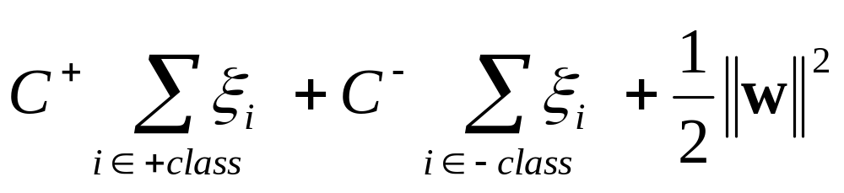
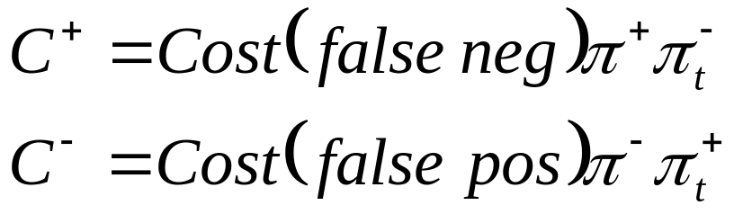
Unbalanced Settings for Classification
Unbalanced Data: relative size of +/- class
encoded as prior probabilities for:
Misclassification Costs: FP vs FN errors
(linear) SVM Classification Formulation:
where

Slide 5
Multi-Class SVM Classifiers
Multiple Classes: J output classes
Problems: usually unbalanced;
misclassification costs (unknown)
Approaches for Multi-Class Problems:
- J one-vs-all binary classifiers
- J(J-1)/2 pairwise binary classifiers

Slide 6
SVM Optimization Algorithms
General-purpose quadratic optimization
- for small data sets (~1,000 samples)
When the kernel matrix does not fit in memory, use:
Chunking methods
- apply QP to a manageable subset of data
- keep only SV’s
- add more data, etc
Decomposition methods (SVMLight, LIBSVM)
- split the data (and parameters) in a number of sets, called ‘working sets’
- perform optimization separately in each set
- Sequential Minimal Optimization (SMO) uses working set of just two points (when analytic solution is possible)

Slide 7
OUTLINE
Practical issues for SVM classifiers
Univariate histograms for SVM classifiers
SVM model selection
Application studies
Summary

Slide 8
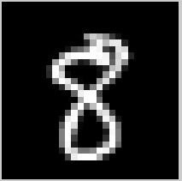
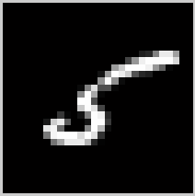
Interpretation of SVM models
Humans can not provide interpretation of high-dimensional data, even when they can make good prediction
Example: vs
How to interpret high-dimensional models?
Project data samples onto normal direction w of SVM decision boundary D(x) = (w x) + b = 0
Interpret univariate histograms of projections

Slide 9
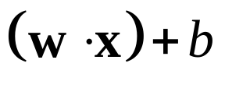
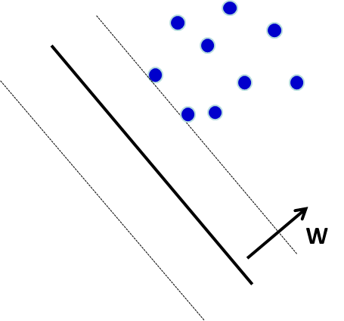
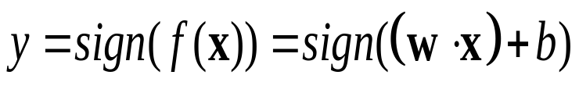
Univariate histogram of projections
Project training data onto normal vector w of the trained SVM
+1
W
0
-1
-1
0
+1

Slide 10
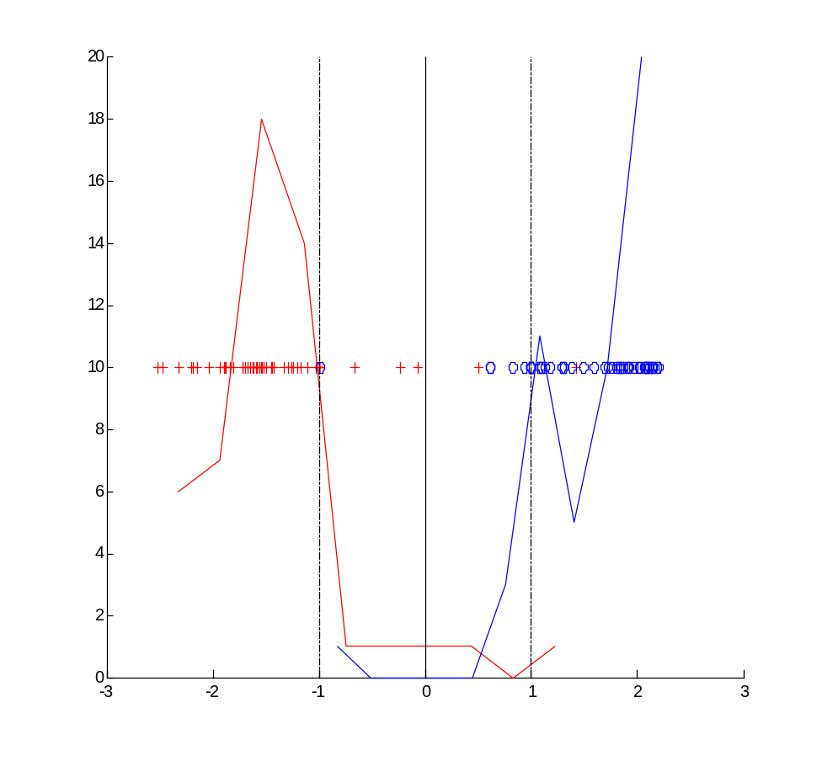
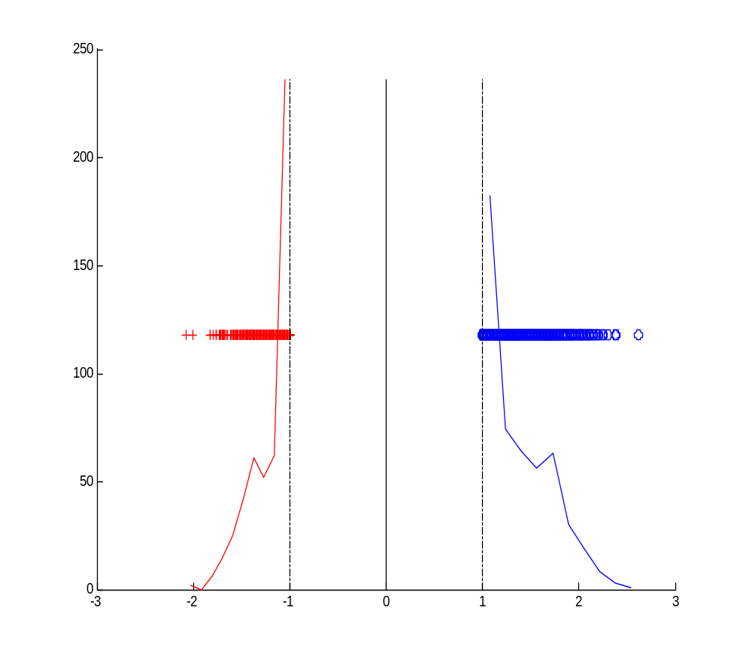
Example histograms
(for balanced high-dimensional training data)
Non separable data
Separable data

Slide 11
OUTLINE
Practical issues for SVM classifiers
Univariate histograms for SVM classifiers
SVM model selection
- General strategies
- Model selection for classification
- Model selection for regression
Application studies
Summary

Slide 12
Strategies for Model Selection
Setting/ tuning of SVM hyper-parameters
- usually performed by experts
- more recently, by non-expert users
Issues for SVM model selection
(1) parameters controlling the ‘margin’ size
(2) kernel type and kernel complexity
Strategies for model selection
- exhaustive search in the parameter space (via resampling)
- using VC analytic bounds
- rule-of-thumb ‘analytic’ strategies (for a particular type of learning problem)

Slide 13
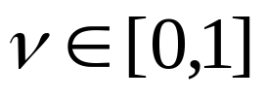


Strategies (continued)
Parameters controlling margin size
- for classification, regularization parameter C
- for regression, the value of epsilon
- for single-class learning, the radius
Complexity control~ fraction of SV’s
- for classification, replace C with
- for regression, specify the fraction of points
allowed to lie outside -insensitive zone
Very sparse data (d/n>>1) → linear SVM

Slide 14
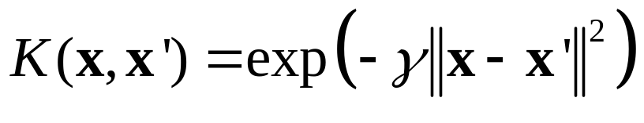
Model Selection for Classification
Parameters C and kernel, via resampling:
Training data + Validation data
Consider RBF kernel
MODEL SELECTION Procedure
[1] Estimate SVM model for each (C, γ) values using the training data.
[2] Select the tuning parameters (C*, γ*) that provide the smallest error for validation data set.
In practice, use K-fold cross-validation

Slide 15
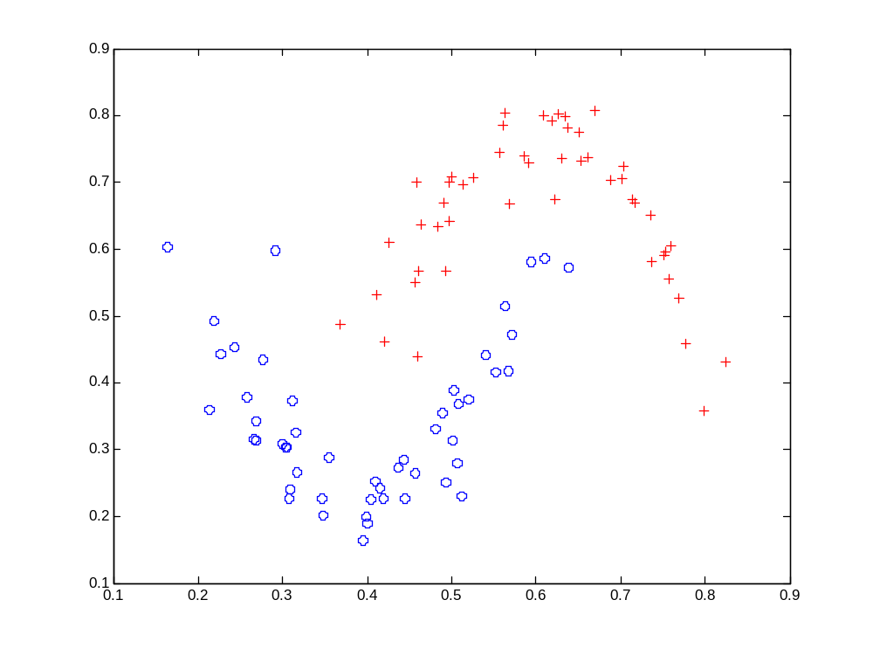


Hyperbolas Data Set
x₁ = ((t-0.4)*3)²+0.225
x₂ = 1-((t-0.6)*3)²-0.225.
for class 1.(Uniform)
for class 2.(Uniform)
Gaussian noise with st. dev. = 0.03 added to both x₁ and x₂
100 Training samples (50 per class)/ 100 Validation.
2,000 Test samples (1000 per class).

Slide 16
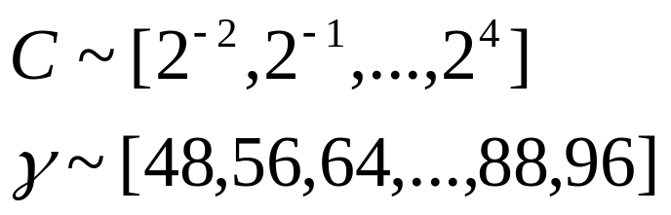
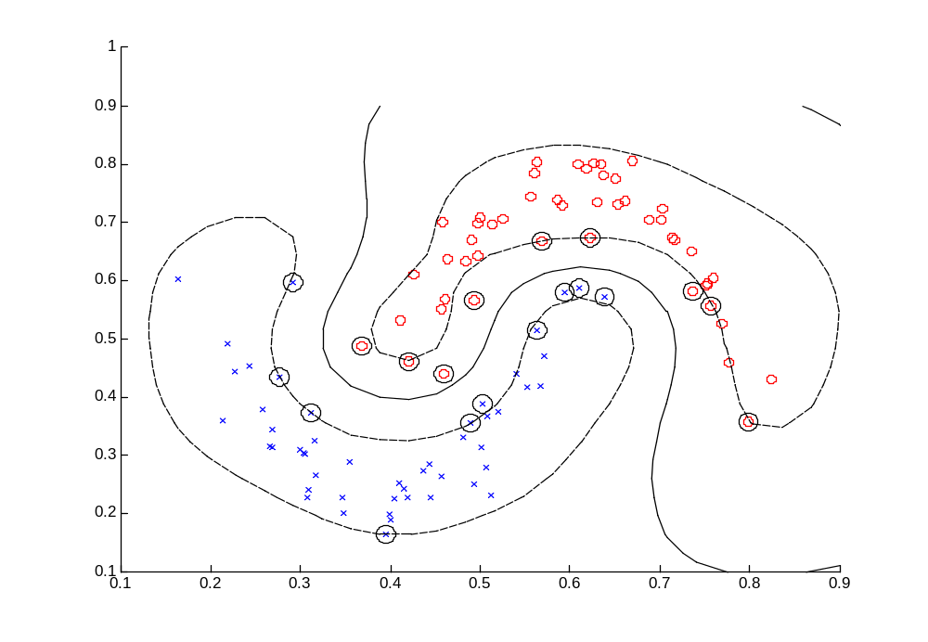
Hyperbolas Example (cont’d)
Range of SVM parameter values:
Optimal values C ~ 2 and γ ~ 64
→ SVM model with training data:

Slide 17
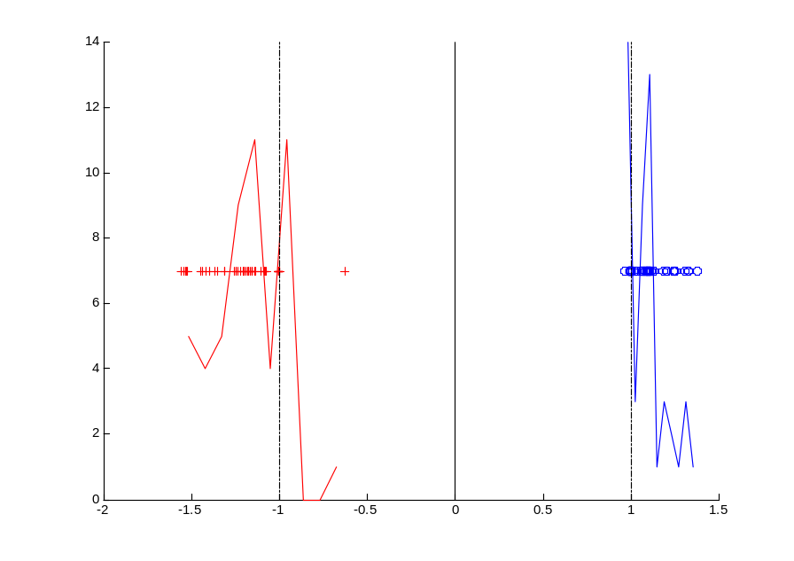
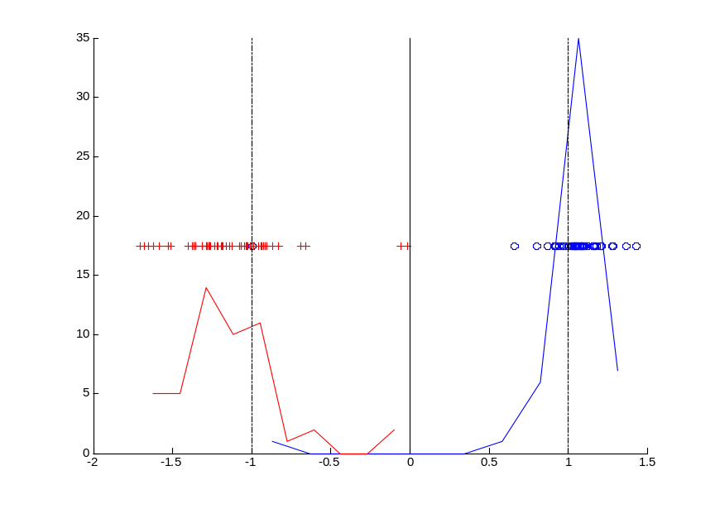
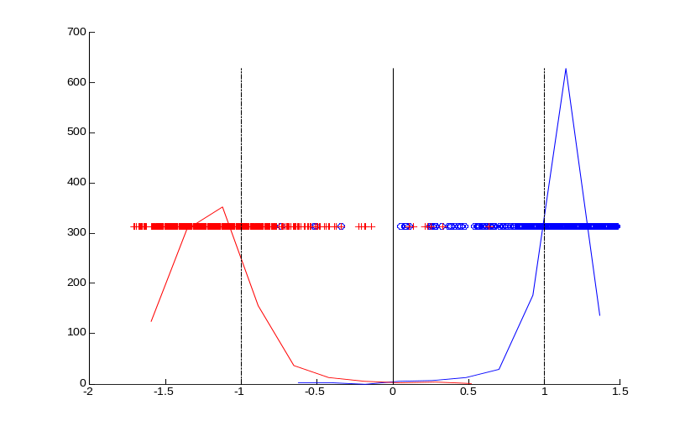
TYPICAL HISTOGRAMs OF PROJECTIONS
(a) Projections of training data (100 samples). Training error=0
(b) Projections of validation data.
Validation error=0 %
(c) Projections of test data (2,000 samples)
Test error =0.55%

Slide 18

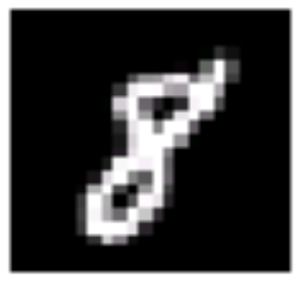
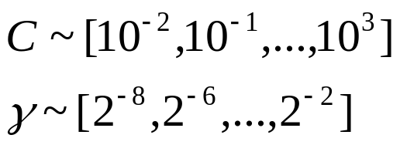
MNIST Data (handwritten digits)
Digit “5” Digit “8”
28 pixels
28 pixels
28 pixels
28 pixels
Binary classification task: digit “5” vs. digit “8”
No. of Training samples = 1000. (500 per class).
No. of Validation samples = 1000.(used for model selection).
No. of Test samples = 1866.
Dimensionality of input space = 784 (28 x 28).
Range of SVM parameters:
Notes:
Test data digit “5” 892 samples, digit “8” 974 samples.

Slide 19
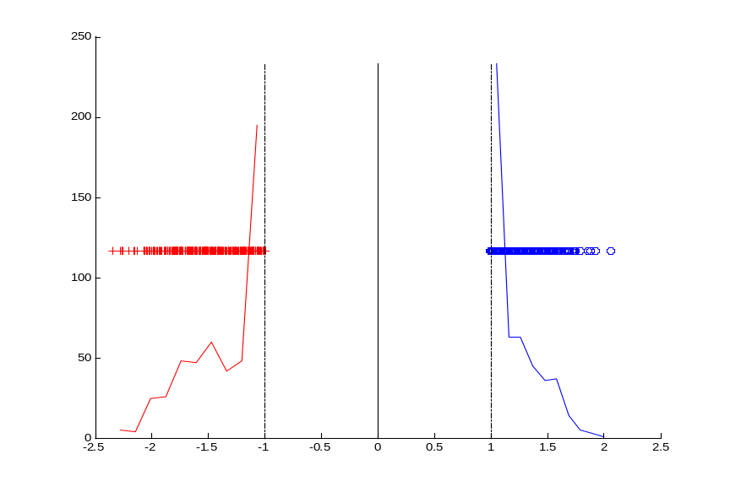
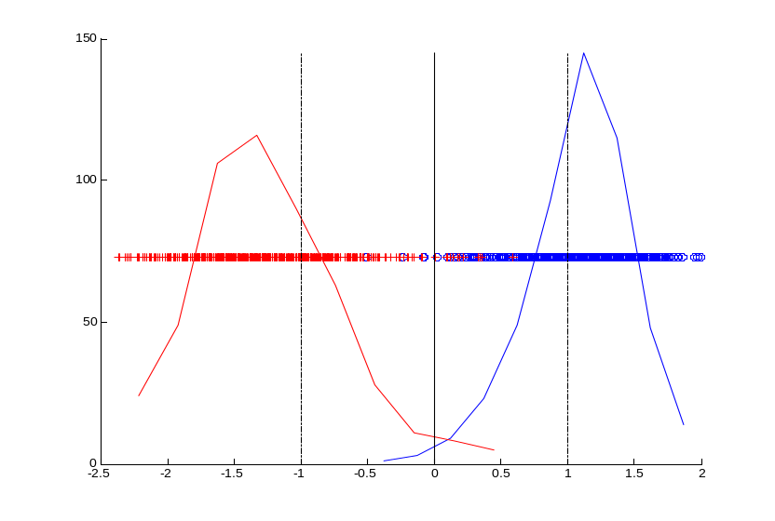
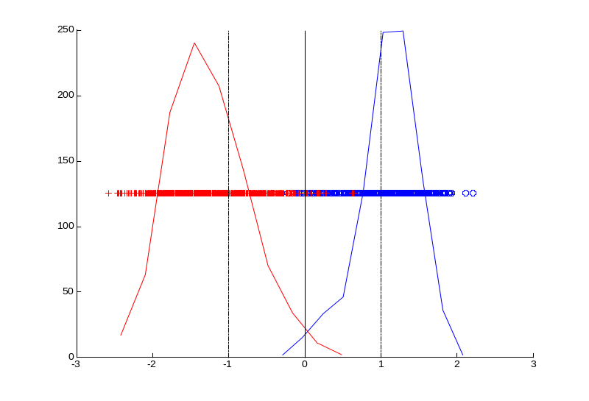
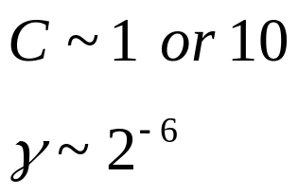
TYPICAL HISTOGRAMs OF PROJECTIONS
Projections of training data (1000 samples). Training error=0
(b) Projections of validation data.
Validation error=1.7%
Selected SVM parameter values
(c) Projections of test data (1866 samples). Test error =1.23%

Slide 20
Model Selection for HDLSS Data
High-Dim. Low Sample Size (HDLSS)
- many applications: genomics, fMRI…
- sample size(~10’s)<<dimensionality (~1000)
Very Ill-Posed Problems
Issues for SVM classifiers
(1) How to apply SVM classifiers to HDLSS?
→ use linear SVM
(2) How to perform model selection?

Slide 21
MNIST data under HDLSS scenario
EXPERIMENTAL SETUP :- Binary classification digit “5” vs. digit “8”
No. of Training samples = 20 (10 per class).
No. of Validation samples = 20 ( for model selection).
No. of Test samples = 1866.
Dimensionality = 784 (28 x 28).
Model estimation method Linear SVM (single tuning parameter C)
TWO MODEL SELECTION STRATEGIES for linear SVM:
Use independent validation set for tuning C
Set C to fixed large value yielding max margin (for training data)
EXPERIMENTAL PROCEDURE: repeat comparison 10 times using 10 independent training/validation data sets

Slide 22
Model selection for HDLSS data (cont’d)
Method: linear SVM Model selection using | Average Test error % (standard deviation %)
separate validation set | 15.4 (3.96)
Fixed setting C=10¹⁰ | 13.8 (2.28)
CONCLUSIONs for HDLSS setting
Use linear SVM classifiers
Resampling for model selection may not work well

Slide 23
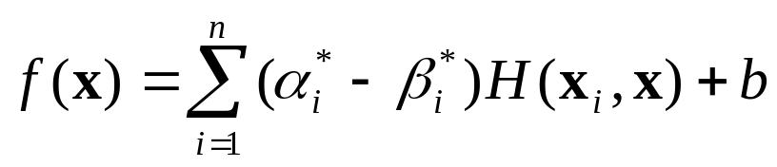
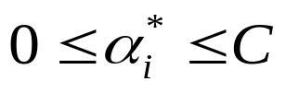




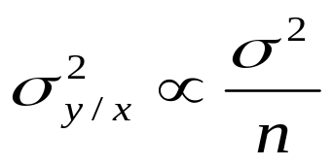
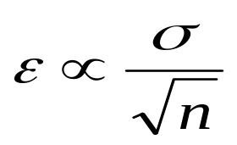
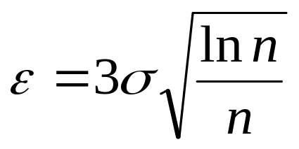
Model Selection for SVM Regression
Selection of parameter C
Recall the SVM solution
where and
→ with bounded kernels (RBF)
Selection of
in general, (noise level)
But this does not reflect dependency on sample size
For linear regression: suggesting
Final prescription

Slide 24
Effect of SVM parameters on test error
Training data
univariate Sinc(x) function
with additive Gaussian noise (sigma=0.2)
(a) small sample size 50 (b) large sample size 200
Prediction Risk
Prediction Risk
0.2
0.2
0.2
0.15
0.15
0.15
0.1
0.1
0.1
0.05
0.05
0.05
0
0
0
0.6
0.6
0.6
0.4
0.4
8
10
10
0.4
8
10
0.2
4
6
6
8
0.2
4
6
0.2
2
2
4
2
epsilon
0
0
0
0
epsilon
0
0
C/n
C/n
C/n

Slide 25
OUTLINE
Practical issues for SVM classifiers
Univariate histograms for SVM classifiers
SVM model selection
Application studies
- Modeling issues preceding learning
- Prediction of transplant-related mortality
- Online fraud detection
Summary

Slide 26
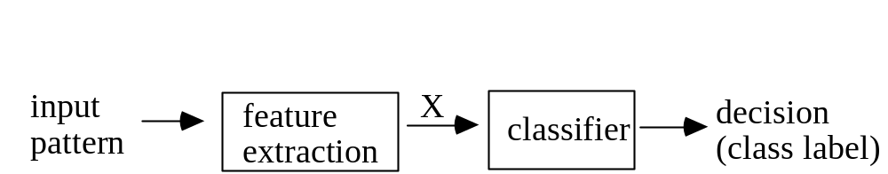
Data Modeling Issues Outside SVM
Generic system (for classification)
Important modeling issues:
- formalization: application → learning problem
- pre-processing + data encoding (Section 2.1)
- preliminary data analysis (~univariate boxplots…)
- feature selection (extraction)
Note 1: these steps precede learning/ model estimation
Note 2: these steps are often neglected, even though they account for 80-90% of success
Note 3: some methods claim to incorporate feature selection into learning (~ deep learning NNs)

Slide 27
Prediction of TRM
Graft-versus-host disease (GVHD) is a common side effect of an allogeneic bone marrow or cord blood transplant.
High Transplant-Related Mortality (TRM): affects ~ 25- 40% of transplant recipients
Hypothesis: specific genetic variants of donor/recipient genes have strong association with TRM
Two data sets: UMN and Mayo Clinic (from the ‘same distribution’)
Problem Formalization: prediction of TRM is modeled via binary classification (SVM)

Slide 28
Available Data for Modeling (UMN)
301 samples (donor/recipient pairs)
- all donor sources: sibling, unrelated, cord
- all stem cell sources: peripheral blood, bone marrow, cord blood
- variety of conditioning regimens
- demographic variables (i.e., Age, Race)
- 136 SNPs for each patient
Unbalanced class distribution
genetic + clinical + demographic inputs
Goal predicting TRM in the first year post-transplant ~ binary classification: alive(+) vs dead(-)

Slide 29
Data Modeling Issues
Generic classification system
Specific issues:
- unbalanced data set
- unequal miscassification costs
- genetic + clinical + demographic inputs
Goals of modeling
- prediction of TRM in the first year post transplant can be formalized as binary classification : alive(+) vs dead(-)
- identification of reliable biomarkers and high risk groups for TRM and GVHD.

Slide 30
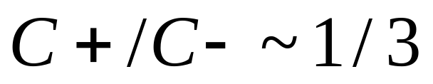
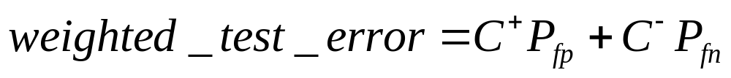
Data Modeling Approach (cont’d)
Feature selection via
(1) classical statistical methods
(2) machine learning methods (information gain ranking, mutual info maximization)
SVM classification (using selected features)
Resampling is used to estimate test error
Prior probabilities: 75% ‘alive’ and 25% ‘dead’
Misclassification costs:
cost of false_positive vs false_negative
Performance index (for comparing classifiers)

Slide 31
Modeling Results: Prediction of TRM
Feature Selection 1: machine learning method
applied to all features (genetic and clinical) yields
agetx, rs3729558, rs3087367, rs3219476, rs7099684, rs13306703, rs2279402
SVM Model 1 (with these 7 featurs)~ test error 29%
Feature Selection 4: Statistical Feature Selection applied to all features yields agetx, donor, cond1, race, rs167715, rs3135974, rs3219463
SVM Model (with these 7 features)~ test error 38%
For comparison: classification rule based on the majority class ~ test error 48%

Slide 32
Modeling Results (cont’d)
Feature Selection 3: machine learning method
applied to genetic features only and then supplemented by clinical inputs provided by domain expert
rs3729558, rs3219476, rs13306703, rs2279402, rs3135974, rs3138360, Rfc5_13053, rs3213391, rs2066782, agetx, donor, cond1 and race
SVM Model 3(using these 13 inputs) ~ test error 29%
Note: different SVM models 1 and 3 provide the same prediction error. Which one is to be interpreted?

Slide 33
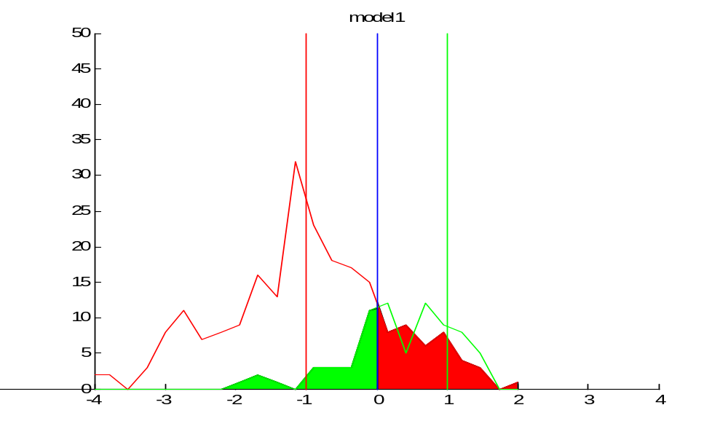
Histogram for SVM Model 1
TP = 62 FP = 56
FN = 13 TN = 170
→ P_error_rate = FP/(TP+FP)=0.47
N_error_rate = FN/(TN+FN)=0.07

Slide 34
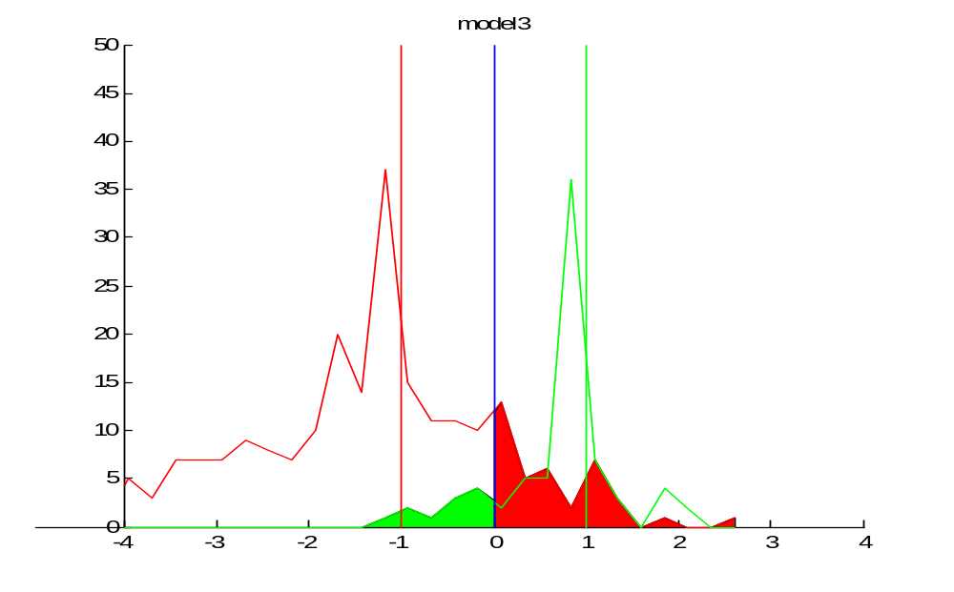
Histogram for SVM Model 3
TP = 68 FP = 45
FN = 7 TN = 181
P_error_rate = FP/(TP+FP)=0.4
N_error_rate = FN/(TN+FN)=0.037

Slide 35
Interpretation of SVM Model 1: input Age
Stats for Age: Ave_AgeTP = 41 Ave_Age FP = 44
Ave_Age FN = 37 Ave_Age TN = 27

Slide 36
Generalization for Mayo Clinic data
UMN data set for training/ Mayo data for testing
→ very poor results ~ 46% test error
Explanation is simple:
- UMN data contained more younger patients
- Recipient_Age input had most predictive value
Note: this violates the original premise that two data sets are (statistically) similar)
Modeling results do not support the original hypothesis that genetic inputs have predictive value.

Slide 37
Online Fraud Detection(D. Chetty 2003)
Background on fraud detection
- On-line transaction processing
- Anti-Fraud strategies
Learning problem set-up (formalization)
Modeling results

Slide 38
Background on fraud detection
Historical Perspective
- mail order (Sears, JC Penney catalogs)
- physical transactions (using credit cards)
- telephone or on-line transactions
Legal liability due to fraud: 3 players ~
customer, retailer, bank (credit card issuer)
Assumption of Risk
traditional retail: bank is responsible
e-commerce: e-tailer assumes the risk

Slide 39
Anti-Fraud Strategies
Balance between
- losing money due to fraud;
- losing/ alienating customers;
- increasing administrative costs
Two main strategies
- Fraud prevention (during the checkout)
- Fraud detection (after the checkout)

Slide 40
Fraud Prevention
Steps during the checkout include:
card authorization (from a bank)
- ensures that the credit card has not been reported as lost or stolen
cardholder authentication
address verification
- via Address Verification System (AVS)
BUT AVS not effective (~ 60% mismatch rate for all transactions)

Slide 41
Fraud Detection (after the checkout)
Two possible approaches:
Rule Based Systems (RBS)
each transaction is compared to a number of rules. For each rule that is hit, the transaction is assigned a score. If the total fraud risk score exceeds a pre-defined threshold, the order is queued for manual review by Credit Risk Team
Machine Learning Approach
combine a priori knowledge with historical data to derive ‘better rules’
Note: a priori knowledge ~ existing rules in RBS

Slide 42
Order processing using RBS
RBS Predicts | Credit Risk Team Decision | Final Order Status
Valid | N/A¹ | Completed²
Fraud | Valid | Completed (after reinstatement) ²
 | Fraud | Cancelled as Known Fraud³
 | Unverifiable | Cancelled as Unverifiable⁴
1 Orders predicted as Valid by the RBS are fulfilled without additional review
2 True status of a completed order is known only after bank notification of
settlement (valid) or chargeback (fraud).
3 Known Fraud classification typically occurs after the Credit Risk team communicates
with the issuing bank.
4 Unverifiable orders are not relevant to this learning problem formulation as we may never know their true nature

Slide 43
Learning Problem Specs
Classification problem set-up includes
Data selection for modeling
- only orders classified as fraud by current RBS system
- orders with amount under $400
during the period November 01 to January 02
→Total 2,331 samples selected (~0.5% of total orders)
Misclassification costs
Good order classified as fraud ~ $10 (5% of ave profit margin)
Fraud order classified as good ~ $200

Slide 44
Misclassification costs |  | Actual
 |  | Fraud | Valid
Predicted | Fraud | $0 | $10
 | Valid | $200 | $0
Prior probabilities
for training data ~ 0.5 for each class
for future (test) data: 0.005 fraud, 0.995 valid

Slide 45
Feature Selection
• Expert Domain Knowledge
input features ~ RBS rules (typically binary features)
Feature selection (dimensionality reduction)
via simple correlation analysis,
i.e. pairwise correlation between each input feature and the output value (valid or fraud).
Common-sense encoding of some inputs
i.e. all email addresses email addresses aggregated into whether or not it was a popular domain (e.g., yahoo.com)
All final inputs turned to be binary categorical
(see next slide)

Slide 46
Feature | Description | Domain
High Risk AVS | True for an Address Verification System code of N, 11, 6, U, or U3 | Yes, No
High Risk State | True for a ship-to state of CA, NY or FL | Yes, No
Popular Domain | True for a popular email domain (yahoo,hotmail) | Yes, No
High Risk Creation Hour | True for orders submitted between the hours of 10pm and 6 am. | Yes, No
High Risk Address | True for orders that have a ship-to address that is identified as high risk | Yes, No
Ship To Velocity rule | True if the same ship-to address has been used often in a time period | Yes, No
Expedited Shipping rule | True if Next Day shipping is requested for the order. | Yes, No
Customer ID Velocity rule | True if the same customer ID has been used often in a single time period. | Yes, No
High Risk Zipcode rule | True for orders that have a ship-to zip code that is identified as high risk by BestBuy.com. | Yes, No
Credit Card Velocity Rule | True if the same credit card has been used often in a single time period | Yes, No
Bill To Ship To Rule | True if the shipping address does not match the billing address on file for the credit card. | Yes, No
Subcat Rule | True if an order line item belongs to a high risk category, e.g., laptops. | Yes, No
HRS Rule | True if a BestBuy.com credit card is being used for the first time to make a purchase. | Yes, No
Order Amount Class | Range (in hundreds) within which the order total falls. | 0,1,2,3
AVS Result | Code returned by the Address Verification System for the customer’s billing address. | X, Y, A, W, Z, U
Creation Hour | The hour of the day when the order was submitted on the online store. | 0, 1, 2,…23

Slide 47
Comparison Methodology
• Classification Methods
CART, k-NN, SVM classifier
Available Data
→ Training(67%) + Test (33%)
Model selection
via 5-fold cross-validation on training data
Prediction accuracy
measured on the test set

Slide 48
Summary of Modeling Results
Test Set | Classific.Accuracy - Fraud | Classific.Accuracy - Valid | Classific. Accuracy - Overall
Rule Based System | 72.43% | 50.69% | 59.46%
k-NN (k=13) | 85.47% | 83.50% | 84.68%
CART (Entropy) | 87.82% | 82.20% | 85.59%
SVM (RBF kernel, with Gamma = 0.3, C = 3) | 86.38% | 84.91% | 85.84%
All methods performed better than RBS
Most important factor is feature selection rather than classification method used

Slide 49
OUTLINE
Practical issues for SVM classifiers
Univariate histograms for SVM classifiers
SVM model selection
Application studies
Summary ~ Importance of:
- Sound problem formalization
- Data preprocessing/ encoding/ feature selection
- Model selection for different SVM problems
- Histogram of projections for SVM classifiers
(can be extended to other SVM formulations)

